Slide 1

Graduate Student Association
Representation & Advocacy
for 7,300 Graduate Students at UB
https://upwp.buffalo.edu/gsa

Slide 2

The Graduate Student Association
The Graduate Student Association (GSA) is a not-for-profit corporation designed to provide services and representation to graduate students at the University at Buffalo.
The GSA is funded through the mandatory student activity fee of $85, so that we can provide these services.

Slide 3



Executive Board
President: J. Coley
gsa-president@buffalo.edu
Vice President: Connor Walters
gsa-vicepresident@buffalo.edu
Treasurer: Joshua Joseph
gsa-treasurer@buffalo.edu

Slide 4
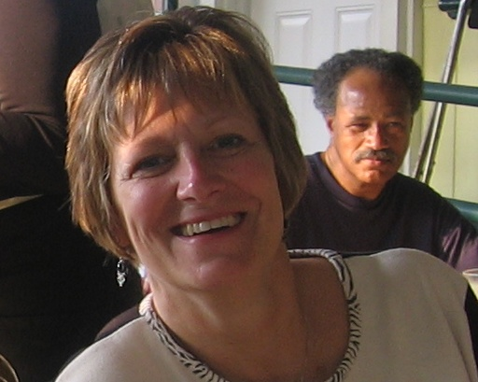
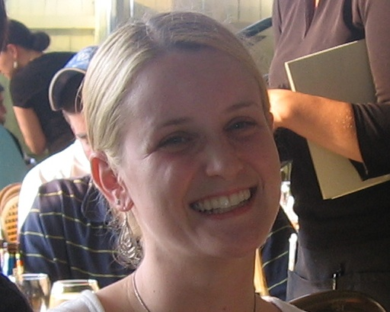
Permanent Staff
Director of Operations: Gena Zimmerman
gmz@buffalo.edu
Director of Operations: Stephanie George
slfrank@buffalo.edu

Slide 5
2020-2021 Student Staff
Mark Diamond Research Fund Director & Assistant: Jennifer Schechter & Braden Brown
gsa-mdrf@buffalo.edu
Managing Editor: Samantha Schichtel-Greenwood gsa-editorial@buffalo.edu
Programming Coordinator: Courtney Doxbeck gsa-programming@buffalo.edu

Slide 6
GSA Funding Opportunities
Departmental, International and Special Interest Club Funding
Conference Funding
Mark Diamond Research Fund (MDRF)
Special Activities Fund
Interdepartmental Activities Fund
Graduate Symposium Fund
Scholarly Publications Fund
Community Outreach Program

Slide 7
GSA Events and Services
GSA Programming
  Java Junctions (Monthly Coffee Socials)
  Sporting Events
  Social and Cultural Outings
  Local tours and events
UB Distinguished Speaker Series
  Free tickets for graduate students
Free Editorial Assistance

Slide 8
Opportunities for Involvement
Finance Committee
Election Committee
Services Committee
Club Officers and Board of Directors Members
The Mark Diamond Research Fund Review Council
Student-Wide Judiciary
Faculty Student Association

Slide 9
Get Involved!
The first GSA Board Meeting is September 9th
@ 6:30pm via Zoom

Slide 10
Welcome to the
University at Buffalo!
Thank you!

